Slide 1
User Groups
Each file has a set of group access rights, and the ID of an established group of users
“World” is a group that contains all users
Other groups must have a file that lists the users in each group
The OS applies group rights, as well as other rights, when deciding whether a process is allowed access to a resource
Computer Management or /etc/group

Slide 2
Administrative Groups
User IDs who are part of the group may perform administrative tasks
Restrict access to administrative functions by blocking the right to execute the programs
Windows also associates other privileges with user groups, including administrative rights
"sudo" or "wheel" group on Linux allows for sudo commands

Slide 3
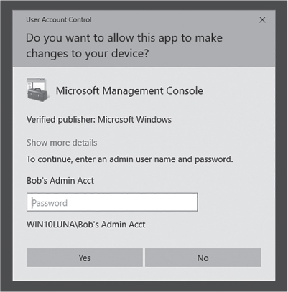
Windows User Account Control
Used with permission from Microsoft.

Slide 4
Special Users/Groups
System
Users
Authenticated Users
IIS_Users
Look at running processes

Slide 5
Administration and Least Privilege
Administrative roles pose a danger
If an admin user executes a Trojan horse program or a virus, the malware can use the administrative rights to modify the OS itself
This risk applies to “root” users and to members of “admin” user groups
Safe alternative: Temporary rights (UAC)
Safe alternative: Have two User IDs
Regular user ID has no special privileges
Special user ID has administrative privileges

Slide 6
File Permission Flags
Traditional Unix uses file permission flags to indicate access rights
Modern Unix systems may also use access control lists (ACLs) – will discuss later
Three sets of RWX flags
Owner Rights (called “user rights” or “u”)
Group Rights (called “group rights” or “g”)
World Rights (called “other rights” or “o”)
Specified in that order: owner-group-world
“rwxrwxrwx” gives everyone full access rights

Slide 7
Unix Permission Flags
Unix keyboard commands use these codes to specify and report on file access rights
Example: “ls” the list directory command:
$ ls -l
total 56
-rw-r--r--@ 1 rick ops 4321 Nov 23 08:58 data1.txt
-rwxr-xr-x 1 rick ops 12588 Nov 23 10:19 hello
-rw-r--r--@ 1 rick rick 59 Nov 23 10:18 hello.c
data1.txt and hello.c are text files
hello is an executable file, owned by “rick”
Everyone can read them, owner can write them

Slide 8
Permissions and Ambiguity
Can Tina read a file with these permissions:
Owner: Bob – RWX
Group: Survey (Bob and Tina) – no access
World: R—
Answer: Depends on the operating system
On OpenVMS: YES
Permissions are combined, then checked
On *nix: NO
Applies the list that applies closest to Tina: the group permissions (right to left)

Slide 9
Access Control Lists (ACLs)
The general-purpose technique clusters access rights by row (by resource, by file)
Simple permission flags require a small, fixed amount of storage for each file
ACLs may be arbitrarily long
Poses a challenge for the OS

Slide 10
Microsoft Windows ACLs
Present in “Professional,” “Business,” and other sophisticated versions of Windows
Each ACL entry gives permission for a specific user or group
Users and groups are defined on the computer or by a network-wide “Domain”
Each entry specifies a list of permissions
Each permission may be “Permit” or “Deny”
Effective permissions are additive

Slide 11
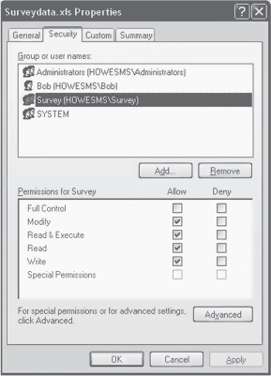
Windows ACL Example
Used with permission from Microsoft.

Slide 12
Default File Protection
Windows uses device, directory, and folder rights to establish default protections
The rights are inherited from enclosing folders
Inheritance is dynamic
If we change rights on an outer folder, it may change rights on an inner folder
Most other ACL implementations are static
Changes do not affect existing rights
We can enable and disable inheritance
Often disabled to apply special rights

Slide 13
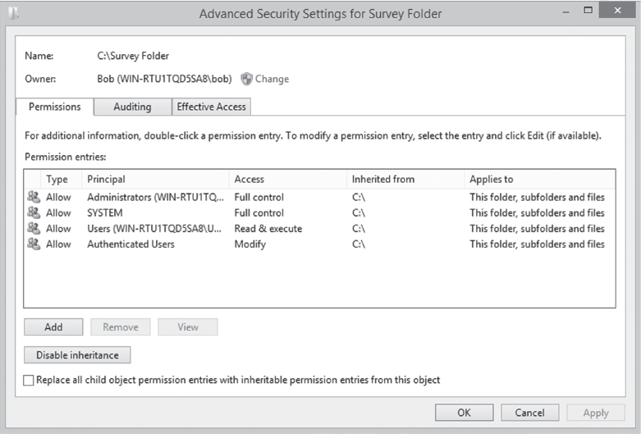
Example of Inherited Rights
Used with permission from Microsoft.

Slide 14
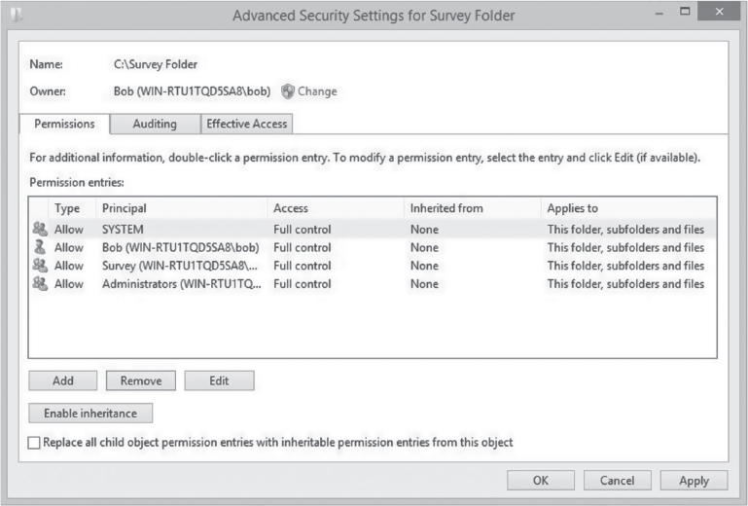
Overriding Inherited Rights
Used with permission from Microsoft.

Slide 15
Additional Local Security
Local Security Policy (GP)
SELinux
policycoreutils-gui: provides system-config-selinux

Slide 16
File Sharing Permissions
Windows/Samba (NFS)
Additive permissions
Combined with local permissions – Most restrictive
Samba share options
read-only or writable
read list or write list

Slide 17
Monitoring System Security
Effective security requires monitoring
Defenses may only detect and delay
Alarms are useless if no one listens
Access controls are preventative – they try to block an attack from succeeding
Monitoring is detective – it detects the attack without necessarily blocking it
Often provided through logs:
Event logs and audit logs

Slide 18
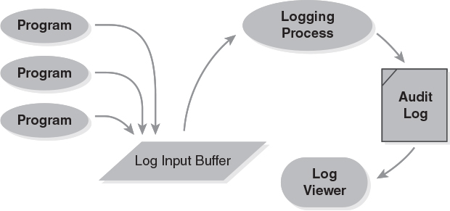
The Event Logging Process

Slide 19
The Logging Mechanisms
A process shared by all system components
A program detects a significant event, and emits a log entry to describe it
The logging process retrieves the event, and discards less-significant events
The logging process saves the event in a log file
Administrators monitor the logs for significant events that demand action
Avoid collecting too few – or too many – events

Slide 20
External Security Requirements
Logging does not directly improve system performance or security – it may help detect and resolve problems, or it might not
Appears more “efficient” to disable logging
Benefits are indirect
Most systems keep logs to comply with External Security Requirements
Based on laws, government regulations, industry standards, or a combination of them

Slide 21
Industry Security Standards
ANSI X-standards
Used by the banking industry to protect electronic funds transfers
PCI-DSS
Used by “Payment Card Industry” to protect credit card transactions
ISO 27000
Family of international standards for security system quality improvement

Slide 22
US Government Standards
FIPS – Federal Info Processing Standards
SOX – Sarbaines-Oxley – financial and accounting standards for public companies
HIPAA – Health information – security standards for certain types of personal health data
GLBA – Gramm-Leach-Bliley – standards for protecting personal financial information
FISMA – Federal information management – security standards for federal computer systems
FERPA – standards for protecting educational information

